Slide 1


STRING
INTRODUCTION

Slide 2






STRING in Python
CONTENTS
( Learning Outcomes ) ☺
XI CS
Introduction : Definition of String, Creation String, Traversal of
String
Operations on String – concatenation/joining, repetition/replication, membership; Functions/methods–
len(), capitalize(), title(), upper(), lower(), count(), find(),
index(), isalnum(), islower(), isupper(), isspace(), isalpha(),
isdigit(), split(), partition(), strip(), lstrip(), rstrip(), replace();
Extra Functions not in the curriculum: startswith(), endswith(), join(), swapcase() String slicing
EXTRA PROGRAMS ON STRING: Palindrome of a string

Slide 3
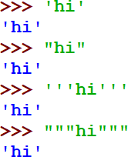
What is a STRING ?
CONTENTS
String is a sequence of characters, which is enclosed between either single (' ') or double quotes (" ") or triple quotation(‘‘‘ ’’’).
Python treats both single and double quotes same.
→Strings Intro:
String Definition Indexing in a String Creation of a String
Traversal of a String.
→Operations on a String
→Functions/methods
→ Strings Slicing;
→Each item/element has its own index number
→Index of first item is 0 and the last item
is n- 1. Here n is number of items in a String.
→Strings are immutable (i.e. unmodifiable) . Thus, every time we perform something on the string that changes it, Python will internally create a new string rather than modifying the old string in place.
→Traversing through a string refers to iterating through the elements of a string one character at a time.

Slide 4
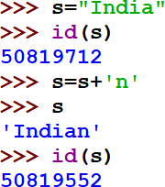
STRINGS ARE IMMUTABLE
CONTENTS
Strings are immutable (i.e. unmodifiable) .
REASON: Every time we perform something on the string that changes it, Python will internally create a new string rather than modifying the old string in place.
→Strings Intro:
String Definition
Indexing in a String Creation of a String
Traversal of a String.
→Operations on a String
→Functions/methods
→ Strings Slicing;
NOTE: New
string created at a different id after modifying the string s

Slide 5
DATA TYPE: STRING in Python
STRINGS in Python
CONTENTS
The index (also called subscript) is the numbered position of a letter in the string. In python, indices begin from
0,1,2,…. upto (length-1) in the forward direction and
-1,-2,-3,….. (-length) in the backward direction.
where length is the length of the string.
→Strings Intro:
String Definition Indexing in a String Creation of a String Traversal of a String.
→Operations on a String
→Functions/methods
→ Strings Slicing;
F O R W A R D I N D E X D I R E C T I O N
0 1 2 3 4 5 6 7 8 9 10 11 12 13 14 15
C | o | m | p | u | t | e | r |  | S | c | i | e | n | c | e
-16 | -15 | -14 | -13 | -12 | -11 | -10 | -9 | -8 | -7 | -6 | -5 | -4 | -3 | -2 | -1
B A C K W A R D
I N D E X
D I R E C T I O N

Slide 6
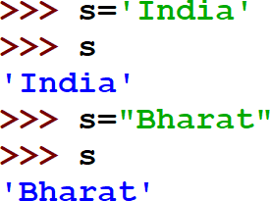
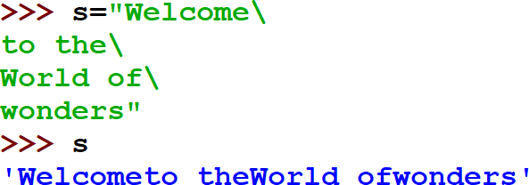
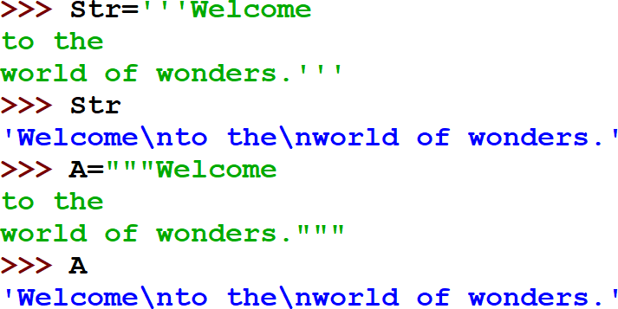
Creation of String
Python allows to have two string types:
1) Single line strings (Basic strings)
Text enclosed in single quote ‘India’ or in double quotes “Bharat” are normally single line strings i.e. they must terminate in one line.
2) Multiline strings
Text spread across multiple lines as one single string.
Two ways of treating multiline strings:-
(i) By adding a backslash at the end of normal single quote/double quote strings.
(ii) By typing the text in triple quotation or
apostrophe mark (No backslash
needed at the end of line)

Slide 7
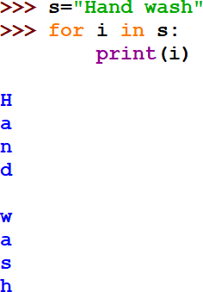
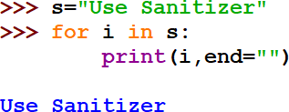
Traversal of a STRING
CONTENTS
→Strings Intro:
String Definition Indexing in a String Creation of a String
Traversal of a String
→Operations on a String
→Functions/methods
→ Strings Slicing;
Traversing through string
Traversing refers to iterating through the elements of a string one character at a time.

Slide 8



OPERATIONS ON STRING

Slide 9
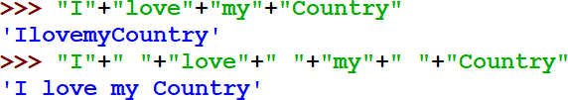
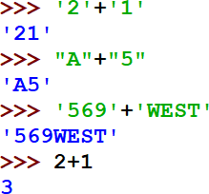

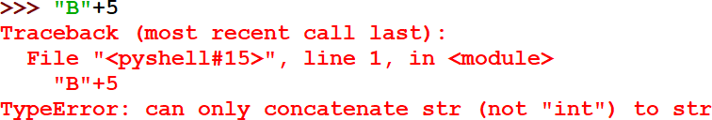
Concatenation / Joining of STRING
+
CONTENTS
operator
→Strings Intro:
→Operations on String
concatenation/ joining
,repetition/replication, membership
→Functions/methods
→ Strings Slicing;
is used for concatenation/joining of strings

Slide 10
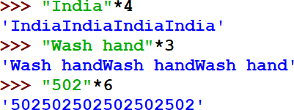

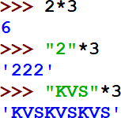
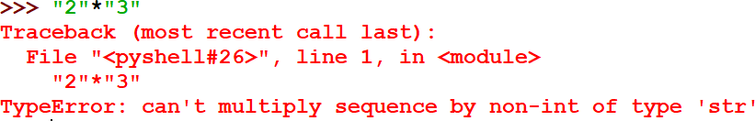
Repetition or Replication STRING
is*used for concatenation/joining of strings
CONTENTS
operator
→Strings Intro:
→Operations on String
concatenation/ joining,
repetition/
replication,
membership
→Functions/methods
→ Strings Slicing;

Slide 11


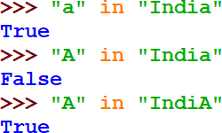
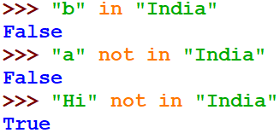
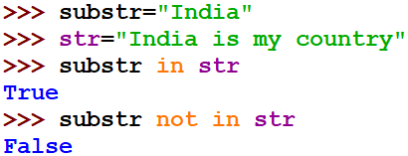
MEMBERSHIP (in/not in) STRING
CONTENTS
Membership operator tests for Membership in a
sequence.Returns Boolean True or False
→Strings Intro:
→Operations on String
concatenation/ joining
,repetition/replication,
membership
,Comparison of String
→Functions/methods
→ Strings Slicing;
OPERATOR | DESCRIPTION
in | Results to True value if it finds a variable at the LHS of in operator in the sequence mentioned in the RHS of the in operator, else it returns False
not in | Results to True value if it does not find a variable at the LHS of in operator in the sequence mentioned in the RHS of the in operator, else it returns False

Slide 12


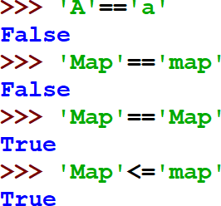
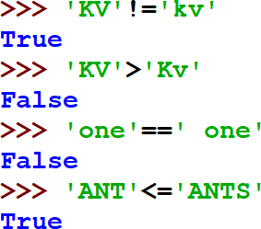

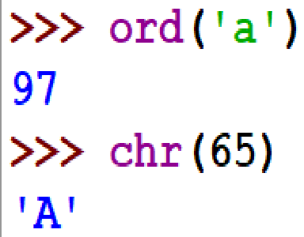

Comparison of STRING
CONTENTS
Comparison Operators <,>,<=,>=,!=,==
→Strings Intro:
→Operations on String
concatenation/ joining
,repetition/replication, membership
,Comparison
of String
→Functions/methods
→ Strings Slicing;
Characters | Ordinal values (Unicode values)
“0” to “9” | 48 to 57
“A” to “Z” | 65 to 90
“a” to “z” | 97 to 122
FOR STRING DATA TYPES →
In ASCII value, A=65,B=66,C=67.....Z=90 a=97,b=98,c=99…… z=122
‘ ’ = 32(blank or white space)
NOTE:
ord() function is used to get the ASCII value of a character
chr() function is used to get the equivalent character of the ASCII no.
NOTE:
ASCII stands for American Standard Code for Information Interchange.

Slide 13



STRING FUNCTIONS/ METHODS

Slide 14
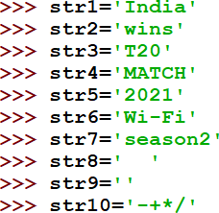
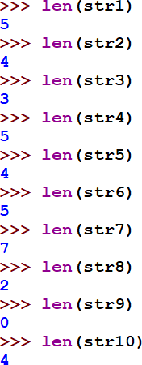

STRING FUNCTION: len()
CONTENTS
len() → function counts the no. of elements/items/characters in the String.
→Strings Intro:
→Operations on String
→Functions/ methods
len(), capitalize(), title(),
count(), find(),index(),
upper(), lower(), islower(), isupper(), isspace(), isdigit(), isalpha(), isalnum(), split(),
partition(), strip(), lstrip(), rstrip(), replace(), startswith(), endswith(), join(), swapcase()
→ Strings Slicing;

Slide 15
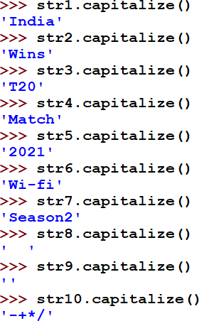

STRING FUNCTION: capitalize()
CONTENTS
capitalize() →Returns a copy of the string with its first character capitalized.
→Strings Intro:
→Operations on String
→Functions/ methods
len(), capitalize(),
title(), count(), find(),index(), upper(),
lower(), islower(), isupper(), isspace(), isdigit(), isalpha(), isalnum(), split(), partition(), strip(), lstrip(), rstrip(), replace(), startswith(), endswith(), join(), swapcase()
→ Strings Slicing;
Only the character at index 0 of the string is capitalized. That is only the first character of the full string is capitalized.

Slide 16
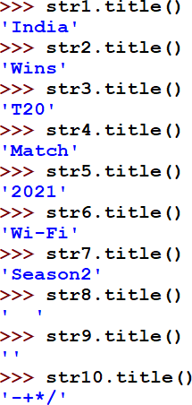

STRING FUNCTION: title()
CONTENTS
title() →Converts the first character of each word
to upper case
→Strings Intro:
→Operations on String
→Functions/ methods
len(), capitalize(),
title(), count(),
find(),index(), upper(),
lower(), islower(), isupper(), isspace(), isdigit(), isalpha(), isalnum(), split(), partition(), strip(), lstrip(), rstrip(), replace(), startswith(), endswith(), join(), swapcase()
→ Strings Slicing;
Every word’s first character is shown in Capital letters.

Slide 17
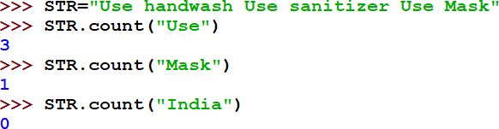
STRING FUNCTION: count()
CONTENTS
→Strings Intro:
→Operations on String
→Functions/ methods
len(), capitalize(), title(),
count(),
find(),index(), upper(),
lower(), islower(), isupper(), isspace(), isdigit(), isalpha(), isalnum(), split(), partition(), strip(), lstrip(), rstrip(), replace(), startswith(), endswith(), join(), swapcase()
→ Strings Slicing;
count() → Returns the number of times a specified value occurs in a string
‘Use’ occurred 3 times in the given string STR
‘Mask’ occurred 1 time in the given string STR
‘India’ is not there in the given string STR. So, 0 times.

Slide 18

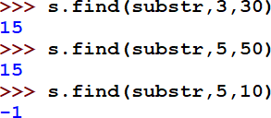
STRING FUNCTION: find()
CONTENTS
find() → Searches the string for a specified value and returns the position of where it was found
→Strings Intro:
→Operations on String
→Functions/ methods
len(), capitalize(), title(),
count(), find(),
index(), upper(), lower(), islower(), isupper(), isspace(), isdigit(), isalpha(), isalnum(), split(), partition(), strip(),
lstrip(), rstrip(), replace(), startswith(), endswith(), join(), swapcase()
→ Strings Slicing;
Substr ‘use’ is found at index 0
Substr ‘use’ is found at index 15 between index no. 3 and 30
Substr ‘use’ is found at index
15 between index no. 3 and 30
Substr ‘use’ is NOT found at between index no. 5 and 10. So, -1 is returned when it is not found.
0 | 1 | 2 | 3 | 4 | 5 | 6 | 7 | 8 | 9 | 1 0 | 1 1 | 1 2 | 1 3 | 1 4 | 1 5 | 1 6 | 1 7 | 1 8 | 1 9 | 2 0 | 2 1 | 2 2 | 2 3 | 2 4 | 2 5 | 2 6 | 2 7 | 2 8 | 2 9 | 3 0 | 3 1 | 3 2 | 3 3 | 3 4 | 3 5 | 3 6 | 3 7
u | s | e |  | h | a | n | d | w | a | s | h |  | , |  | u | s | e |  | s | a | n | i | t | i | z | e | r | , |  | u | s | e |  | m | a | s | k

Slide 19
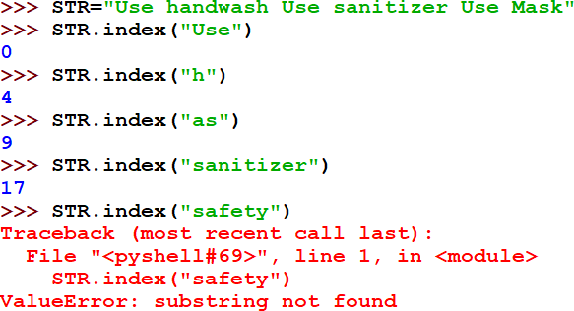
STRING FUNCTION: index()
CONTENTS
index() →Searches the string for a specified value and returns the position of where it was found
→Strings Intro:
→Operations on String
→Functions/ methods
len(), capitalize(), title(), count(), find(),
index(), upper(),
lower(), islower(), isupper(), isspace(), isdigit(), isalpha(), isalnum(), split(), partition(), strip(), lstrip(), rstrip(), replace(), startswith(), endswith(), join(), swapcase()
→ Strings Slicing;

Slide 20
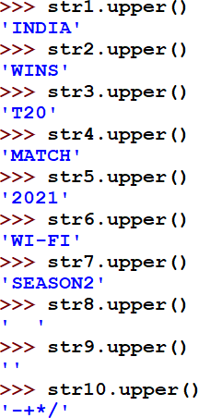
STRING FUNCTION: upper()
CONTENTS
upper() →
Returns a copy of the string converted to upper case
→Strings Intro:
→Operations on String
→Functions/ methods
len(), capitalize(), title(), count(), find(),
index(), upper(),
lower(), islower(), isupper(), isspace(), isdigit(), isalpha(), isalnum(), split(), partition(), strip(), lstrip(), rstrip(), replace(), startswith(), endswith(), join(), swapcase()
→ Strings Slicing;

Slide 21
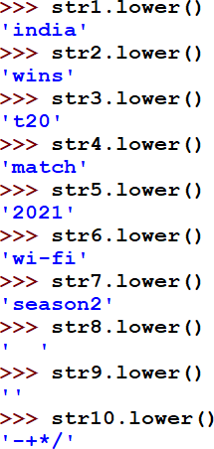
STRING FUNCTION: lower()
CONTENTS
lower() →
Returns a copy of the string converted to lowercase.
→Strings Intro:
→Operations on String
→Functions/ methods
len(), capitalize(), title(), count(), find(),
index(), upper(),
lower(), islower(),
isupper(), isspace(), isdigit(), isalpha(), isalnum(), split(),
partition(), strip(), lstrip(), rstrip(), replace(), startswith(), endswith(), join(), swapcase()
→ Strings Slicing;

Slide 22
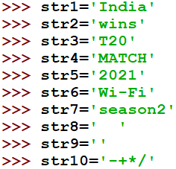
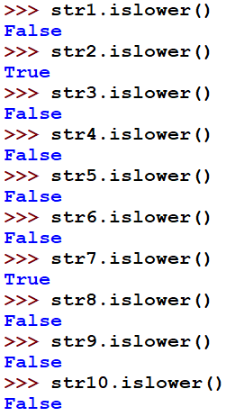
STRING FUNCTION: islower()
CONTENTS
Returns True if all cased characters in the string are lowercase.
There must be at least one character. It returns False otherwise.
**All the characters must be in small letters for the function to return True.
** Blank spaces or any other special characters or empty string returns False.
→Strings Intro:
→Operations on a String
→Functions/ methods
len(), capitalize(), title(), count(), find(),
index(), upper(), lower(),
islower(), isupper(),
isspace(), isdigit(), isalpha(), isalnum(), split(), partition(), strip(),
lstrip(), rstrip(), replace(), startswith(), endswith(), join(), swapcase()
→ Strings Slicing;

Slide 23
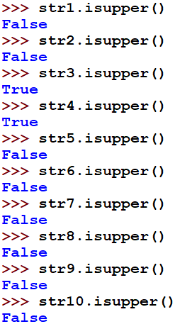
STRING FUNCTION: isupper()
CONTENTS
Returns True if all cased characters in the string are uppercase. There must be at least one character. It returns False otherwise. **All the characters must be in CAPITAL letters for the function to return True. ** Blank spaces or any other special characters or empty string returns False.
→Strings Intro:
→Operations on a String
→Functions/ methods
len(), capitalize(), title(), count(), find(),
index(), upper(), lower(),
islower(), isupper(),
isspace(), isdigit(), isalpha(), isalnum(), split(), partition(), strip(),
lstrip(), rstrip(), replace(), startswith(), endswith(), join(), swapcase()
→ Strings Slicing;

Slide 24
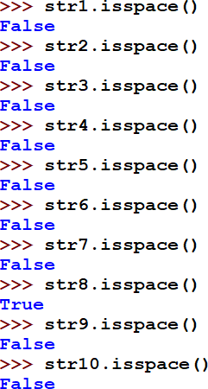
STRING FUNCTION: isspace()
CONTENTS
isspace() →Returns True if all characters in the string are whitespaces.
** Any string other than only whitespaces returns False.
**An empty string also returns False
→Strings Intro:
→Operations on a String
→Functions/
methods
len(), capitalize(), title(), count(), find(),
index(), upper(), lower(), islower(), isupper(), isspace(), isdigit(), isalpha(), isalnum(), split(),
partition(), strip(), lstrip(), rstrip(), replace(), startswith(), endswith(), join(), swapcase()
→ Strings Slicing;

Slide 25
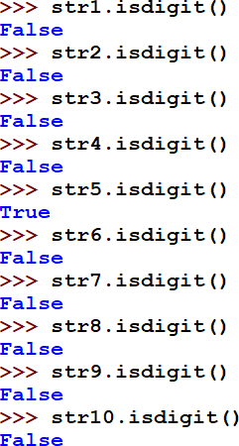
STRING FUNCTION: isdigit()
CONTENTS
Returns True if all characters in the string are digits
**All the characters must be digits for the function to return True.
** Blank spaces or any other special characters or
empty string returns False.
→Strings Intro:
→Operations on a String
→Functions/ methods
len(), capitalize(), title(), count(), find(),
index(), upper(), lower(),
islower(), isupper(), isspace(), isdigit(), isalpha(), isalnum(), split(), partition(), strip(), lstrip(), rstrip(), replace(), startswith(), endswith(), join(), swapcase()
→ Strings Slicing;

Slide 26
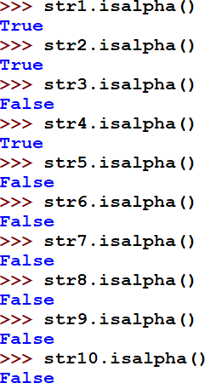
STRING FUNCTION: isalpha()
CONTENTS
Returns True if all characters in the string are in the alphabet
**All the characters must be alphabet for the
function to return True.
** Blank spaces or any other special characters or digits with alphabet or empty string returns False.
→Strings Intro:
→Operations on a String
→Functions/ methods
len(), capitalize(), title(), count(), find(),
index(), upper(), lower(),
islower(), isupper(), isspace(), isdigit(), isalpha(), isalnum(), split(), partition(), strip(), lstrip(), rstrip(), replace(), startswith(), endswith(), join(), swapcase()
→ Strings Slicing;

Slide 27
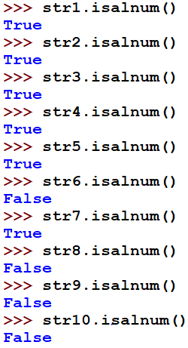
STRING FUNCTION: isalnum()
CONTENTS
Returns True if all characters in the string are alphanumeric
**All the characters must be alphabet or number or a combination of alphabet and number for the function to return True.
** Blank spaces or presence of any other special
characters or empty string returns False.
→Strings Intro:
→Operations on a String
→Functions/ methods
len(), capitalize(), title(), count(), find(),
index(), upper(), lower(),
islower(), isupper(), isspace(), isdigit(), isalpha(), isalnum(), split(), partition(), strip(), lstrip(), rstrip(), replace(), startswith(), endswith(), join(), swapcase()
→ Strings Slicing;

Slide 28
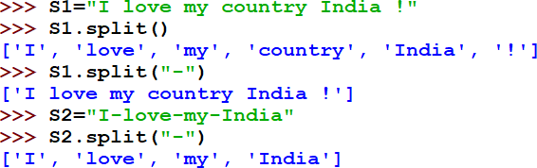
STRING FUNCTION: split()
CONTENTS
split() → Splits the string at the specified separator, and returns a List.
The default character for splitting is
whitespace.
One can specify their own character on the basis of which splitting is to be done.
→Strings Intro:
→Operations on a String
→Functions/ methods
len(), capitalize(), title(), count(), find(),
index(), upper(), lower(), islower(), isupper(),
isspace(), isdigit(),
isalpha(), isalnum(), split(), partition(), strip(), lstrip(), rstrip(), replace(), startswith(), endswith(), join(), swapcase()
→ Strings Slicing;
Split returns a list by separating the elements through whitespaces by default
Here, Split returns a list by separating the elements through ‘-’

Slide 29
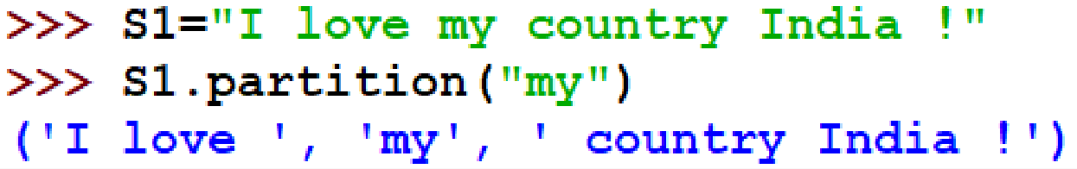







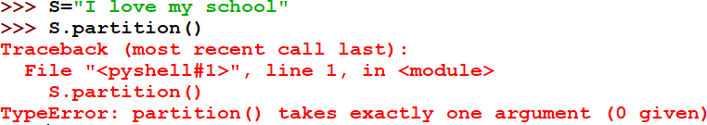
STRING FUNCTION: partition()
CONTENTS
Returns a Tuple where the string is parted into three parts.
The parts returned as the elements of the Tuple are:
Portion before the argument from the whole
string
The argument sent with the partition() function
Portion after the argument in the whole string.
→Strings Intro:
→Operations on a String
→Functions/ methods
len(), capitalize(), title(), count(), find(),
index(), upper(), lower(), islower(), isupper(),
isspace(), isdigit(),
isalpha(), isalnum(), split(), partition(), strip(), lstrip(), rstrip(), replace(), startswith(), endswith(), join(), swapcase()
→ Strings Slicing;
(i) Portion before argument
(ii) The argument
(iii) Portion after argument
Here, “my” is the argument sent with the partition function.
Partition() needs atleast one argument

Slide 30

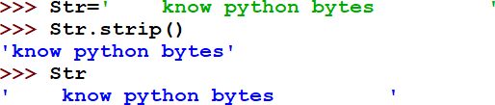
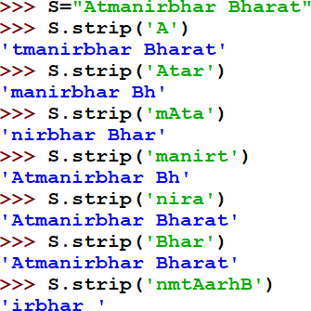
STRING FUNCTION: strip()
Returns a trimmed version of the string. Trimming is done only when cases are matched with any of the characters in the argument from both sides of the string (beginning and end).
By default, if there is no argument mentioned then, whitespaces are removed from both the beginning of the string and end of the whole string. But, no change in the original string as Strings are immutable. Cases matched.
CONTENTS
→Strings Intro:
→Operations on a String
→Functions/ methods
len(), capitalize(), title(), count(), find(),
index(), upper(), lower(), islower(), isupper(), isspace(), isdigit(), isalpha(),
isalnum(), split(), partition(), strip(), lstrip(), rstrip(), replace(), startswith(), endswith(), join(), swapcase()
→ Strings Slicing;
Atmanirbhar Bharat
Atmanirbhar Bharat
Atmanirbhar Bharat
Atmanirbhar Bharat
Atmanirbhar Bharat
Atmanirbhar Bharat
Atmanirbhar Bharat

Slide 31

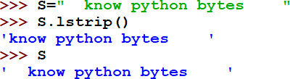
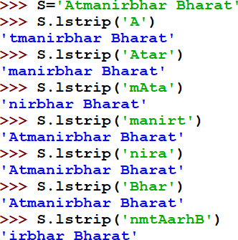
STRING FUNCTION: lstrip()
CONTENTS
Returns a LEFT trimmed version of the string. Trimming is done only when cases are matched with any of the characters in the argument from LEFT side of the string (beginning ).
→Strings Intro:
→Operations on a String
→Functions/ methods
len(), capitalize(), title(),
count(), find(),
index(), upper(), lower(), islower(), isupper(), isspace(), isdigit(), isalpha(), isalnum(), split(), partition(), strip(), lstrip(), rstrip(), replace(), startswith(), endswith(), join(), swapcase()
→ Strings Slicing;
By default, if there is no argument mentioned then, whitespaces are removed from the beginning of the string only (LEFT side). But, no change in the original string as Strings are immutable. Cases matched.
Atmanirbhar Bharat
Atmanirbhar Bharat
Atmanirbhar Bharat
Atmanirbhar Bharat
Atmanirbhar Bharat
Atmanirbhar Bharat
Atmanirbhar Bharat

Slide 32

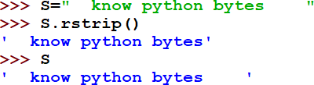
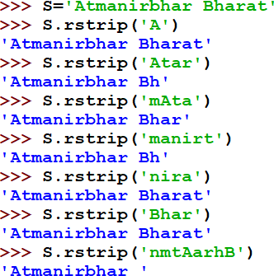
STRING FUNCTION: rstrip()
CONTENTS
Returns a RIGHT trimmed version of the string. Trimming is done only when cases are matched with any of the characters in the argument from RIGHT side of the string (end ).
→Strings Intro:
→Operations on a String
→Functions/ methods
len(), capitalize(), title(), count(), find(),
index(), upper(), lower(),
islower(), isupper(), isspace(), isdigit(), isalpha(), isalnum(), split(), partition(), strip(), lstrip(), rstrip(), replace(), startswith(), endswith(), join(), swapcase()
→ Strings Slicing;
By default, if there is no argument mentioned then, whitespaces are removed from the end of the string only (RIGHT side). But, no change in the original string as Strings are immutable. Cases matched.
Atmanirbhar Bharat
Atmanirbhar Bharat
Atmanirbhar Bharat
Atmanirbhar Bharat
Atmanirbhar Bharat
Atmanirbhar Bharat
Atmanirbhar Bharat

Slide 33
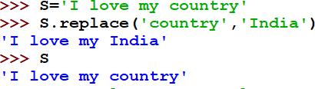






STRING FUNCTION: replace()
CONTENTS
Replace() →Returns a string where a specified value is replaced with a specified value
→Strings Intro:
→Operations on a String
→Functions/ methods
len(), capitalize(), title(), count(), find(),
index(), upper(), lower(), islower(), isupper(), isspace(), isdigit(), isalpha(), isalnum(),
split(), partition(), strip(), lstrip(), rstrip(),
replace(),
startswith(), endswith(),
join(), swapcase()
→ Strings Slicing;
1st Argument
₂nd
Argument
The first argument in the replace () function is replaced by the second argument.
Strings are immutable. Hence, there is no change in the Original_str. But, when it is assigned
to another string, Newstr, the change is visible.

Slide 34
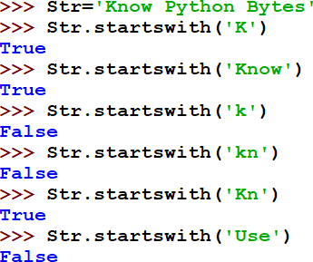
STRING FUNCTION: startswith()
CONTENTS
startswith() →Returns true if the string starts with the specified value
→Strings Intro:
→Operations on a String
→Functions/ methods
len(), capitalize(), title(), count(), find(),
index(), upper(), lower(), islower(), isupper(),
isspace(), isdigit(), isalpha(), isalnum(), split(), partition(), strip(), lstrip(), rstrip(), replace(),
startswith(),
endswith(), join(), swapcase()
→ Strings Slicing;

Slide 35
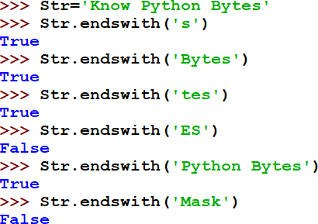
STRING FUNCTION: endswith()
CONTENTS
endswith() →Returns true if the string ends with the specified value
→Strings Intro:
→Operations on a String
→Functions/ methods
len(), capitalize(), title(), count(), find(),
index(), upper(), lower(), islower(), isupper(),
isspace(), isdigit(), isalpha(), isalnum(), split(), partition(), strip(), lstrip(), rstrip(), replace(),
startswith(),
endswith(), join(),
swapcase()
→ Strings Slicing;

Slide 36



STRING FUNCTION: join()
CONTENTS
Join() → Joins the elements of an iterable to the end of the string
 | Joining String iterable elements
→Strings Intro:
→Operations on a String
→Functions/ methods
len(), capitalize(), title(), count(), find(),
index(), upper(), lower(), islower(), isupper(),
isspace(), isdigit(), isalpha(), isalnum(), split(), partition(), strip(), lstrip(), rstrip(), replace(),
startswith(), endswith(),
join(), swapcase()
→ Strings Slicing;
Joining List iterable elements
Joining Tuple iterable elements

Slide 37


STRING FUNCTION: swapcase()
CONTENTS
→Strings Intro:
→Operations on a String
→Functions/ methods
len(), capitalize(), title(), count(), find(),
index(), upper(), lower(),
islower(), isupper(), isspace(), isdigit(), isalpha(), isalnum(), split(), partition(), strip(), lstrip(), rstrip(), replace(), startswith(), endswith(), join(), swapcase()
→ Strings Slicing;
Swapcase() →
Swaps cases, lower case becomes upper case and vice versa

Slide 38


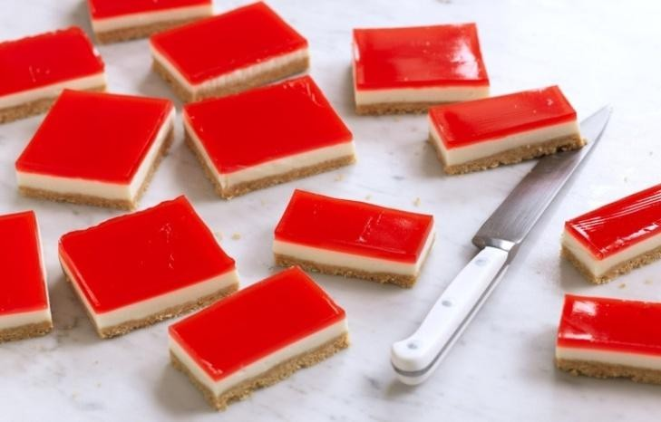

STRING SLICING

Slide 39

STRING slicing
L[start:stop] creates a string slice (substring) out of the given string with elements falling between indexes start and stop, not including value at the stop
index.
L[start:stop:step] creates a string slice (substring) out of the given string with elements falling between indexes start and stop, not including value at the stop index, and skipping step elements in between.
NOTE: In absence of any start, stop, step values, we have Default start index as the beginning, stop index as the last index and step value as +1.
F O R W A R D
I N D E X
D I R E C T I O N
0 | 1 | 2 | 3 | 4 | 5 | 6 | 7 | 8 | 9 | 10 | 11 | 12 | 13 | 14 | 15 | 16 | 17
K | N | O | W |  | P | Y | T | H | O | N |  | B | Y | T | E | S | !
-18 | -17 | -16 | -15 | -14 | -13 | -12 | -11 | -10 | -9 | -8 | -7 | -6 | -5 | -4 | -3 | -2 | -1
B A C K W A R D
I N D E X
D I R E C T I O N

Slide 40
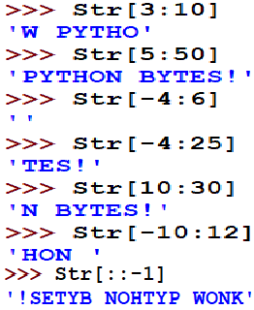
STRING slicing
0 | 1 | 2 | 3 | 4 | 5 | 6 | 7 | 8 | 9 | 10 | 11 | 12 | 13 | 14 | 15 | 16 | 17
K | N | O | W |  | P | Y | T | H | O | N |  | B | Y | T | E | S | !
-18 | -17 | -16 | -15 | -14 | -13 | -12 | -11 | -10 | -9 | -8 | -7 | -6 | -5 | -4 | -3 | -2 | -1
Start index 3, stop index is (10-1=9)
Start index 5, stop index is 50 which is beyond the last index in forward direction. Hence, it will stop at the last index
Start index -4(backward), stop index is (6-1=5 (forward)). Here, it
is not getting any value in the range, hence empty.
Start index -4(which is ‘T’ as per the backward index,) stop index is 25 which is beyond the last index. Hence, it will stop at the last index.
Start index 10, stop index is 30 which is beyond the last index in forward direction. Hence, it will stop at the last index
Start index -10(which is ‘H’ as per the backward index,) stop index is 12- 1=11 (forward indexing). Hence, it will stop at the (stop index-1)., an
empty whitespace ‘ ’ is at 11 index no.
The entire sequence of characters get reversed as the default start and stop values are taken and step is given as -1

Slide 41
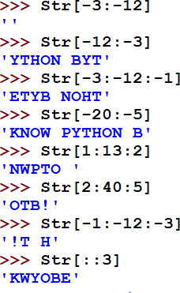
STRING slicing
0 | 1 | 2 | 3 | 4 | 5 | 6 | 7 | 8 | 9 | 10 | 11 | 12 | 13 | 14 | 15 | 16 | 17
K | N | O | W |  | P | Y | T | H | O | N |  | B | Y | T | E | S | !
-18 | -17 | -16 | -15 | -14 | -13 | -12 | -11 | -10 | -9 | -8 | -7 | -6 | -5 | -4 | -3 | -2 | -1
Start index -3(backward), stop index is -12(backward). Here, it is not getting any value in the range as no step value mentioned in reverse. Hence empty.
Start index -12(which is ‘Y’ as per the backward index,) stop index is -3 (which takes values till index -3-1= -4). Here, -4 is ‘T’
Start index -3(backward), stop index is -12(backward). Here, it is getting value in the range as step value is -1 mentioned in reverse.
Start index -20(which is beyond backward index,) stop index is -5
which takes value till (-5-1=-6). Here, -6 is ‘N’.
Start index 1, stop index is 13 (till 13-1=12),step value is 2 in forward direction. Hence, it will fetch/take alternate elements with a skip of 1 value in between
Try to understand yourself.
Default start and stop is beginning and end index of the list.
Here, step is 3.

Slide 42


DATA TYPE: working with some more STRING examples
0 | 1 | 2 | 3 | 4 | 5 | 6 | 7 | 8 | 9 | 10 | 11 | 12 | 13 | 14 | 15 | 16 | 17 | 18
C | o | m | p | u | t | e | r |  | S | c | i | e | n | c | e | ! | ! | !
-19 | -18 | -17 | -16 | -15 | -14 | -13 | -12 | -11 | -10 | -9 | -8 | -7 | -6 | -5 | -4 | -3 | -2 | -1

Slide 43



PROGRAMS ON
STRING

Slide 44

HINT: TRY OUT IN ANOTHER WAY:
If string==string[::-1]
#Loop else clause, gets executed if the loop terminates normally.
OUTPUT

Slide 45
Bibliograhy and References
Google
Wikipedia
w3schools
XI Computer Science , By Sumita Arora, Dhanpat Rai Publication 2020 Edition

Slide 46



Programming is an ART….
Add your colours to it and make your own

